Slide 1

Eco-Clean
Design and Implementation of an Affordable, PWA-Enabled Digital Operations Web Application for Workforce Scheduling and Management in Small Businesses
Vidarshan Rathnayake | Upul Atapattu
CSIS 4495 002

Slide 2

Background
Small service-providing businesses such as cleaning companies often rely on manual scheduling, spreadsheets, and fragmented communication methods to coordinate day-to-day operations. These practices increase administrative overhead, create scheduling conflicts, and limit operational visibility.
This project investigates whether a centralized digital platform can provide an affordable and scalable alternative for workforce scheduling, staff management, and appointment coordination.

Slide 3
Research Methods
Interviews
Conducted multiple discussions with the client to understand operational workflows, challenges, and business needs.
Shadowing
Observed day-to-day administrative tasks (scheduling, coordination) to identify inefficiencies in real scenarios.
Platform Analysis
Reviewed existing tools and solutions to evaluate limitations and gaps in current approaches.
Technology Research
Explored modern tech stacks and frameworks suitable for scalable, cost-effective implementation.
Design Decisions
Translated insights into system architecture and feature design aligned with business needs

Slide 4
Evolution of the Project
🧩 Initial Proposal
🗣️ Partner Feedback
⚙️ Transformation
🚀 Final System
Web scheduling platform
Mobile apps (iOS & Android)
Booking & dashboards
Maps + notifications
No client booking needed
Staff travel-based work
GPS time tracking
Availability & leave
Shift to PWA
Expanded from scheduling → full operations system
Role-based access control
Admin Web scheduling platform
Staff Interface via PWA
Time tracking via work sessions
Workforce management (Leave, Availability)
Payroll and pay statement generation
AI features

Slide 5





Technology Stack
NEXTJS
SUPABASE
PRISMA
TYPESCRIPT
MANTINE
FULLCALENDER
OPEN AI
PWA
UPLOADTHING
RESEND
VERCEL
Frontend: Next.js, React, Mantine UI
Backend: Next.js API routes (full-stack)
Typescript: Strongly Typed Full-Stack Development
Database: PostgreSQL + Prisma ORM
Auth: NextAuth with role-based access
FullCalendar for scheduling UI
Resend (emails), UploadThing (file uploads)
Deployment via Vercel, AI via OpenAI

Slide 6
Major Results & Anticipated Implications
Operational Fit
The system aligns closely with the real workflow needs of a small business, around scheduling, staff coordination and payroll functions.
Cost Sensitivity
The PWA-first strategy emerged as a more sustainable option than separate native mobile apps for internal staff use.
✔ Improved workforce coordination and visibility
✔ Reduced manual scheduling effort
✔ More accurate staff time tracking
✔ Better organizational transparency
✔ Scalable digital foundation for future automation
Architecture Matters
A unified Next.js full-stack approach, simplified UI–API, co-location, improving maintainability and reducing complexity.
Deployment Reality
Cloud deployment revealed challenges in schema migration, environment setup, and TypeScript validation.

Slide 7

Key Features
Workforce Scheduling
Mobile Staff Workflow (PWA)
Time Tracking & Operational Transparency
Payroll Management
Automated Emails for Clients
AI-Powered Task Assistance

Slide 8
Challenges Encountered
🗄️ Database Migration Conflicts
🔐 Authentication
🚀 Deployment (Vercel)
💰 Payroll Complexity
🌍 Time Zone
⚠️ Multiple schema versions caused inconsistencies
✔ Unified schema + stabilized Prisma migrations
⚠️ IssuesSession mismatch & incorrect role assignments
✔ Rebuilt NextAuth + enforced role-based access
⚠️ TypeScript errors & environment mismatches
✔ Improved type safety + standardized env variables
⚠️ No APIs for Canadian/Quebec payroll rules
✔ Built custom logic + manual override system
⚠️ HandlingPST vs EST scheduling inconsistencies
✔ Stored time in UTC + frontend conversion

Slide 9
Learning
🧠 Core Principles
Systems must be workflow-driven, not feature-based
Handling real-world data is complex (time, payroll, users)
Cost vs scalability is a critical design trade-off
🤖 AI in Modern Systems
Should be Controlled
Should be Structured
Should be Value-driven (not just a feature)
🚀 Engineering Mindset
Continuous learning is required to stay relevant in modern development in the age of AI
building real systems is about designing workflows, not just features.

Slide 10
Conclusion
Eco-Clean Web demonstrates that a unified digital platform can significantly improve operational efficiency in service-based businesses.
The system successfully integrates:
• scheduling
• staff management
• time tracking
• payroll
• AI-assisted decision support
Beyond the implementation, this project provides a practical framework for how small businesses can adopt digital transformation in a cost-effective and scalable manner.
The solution also lays the foundation for future enhancements such as:
• analytics dashboards
• AI-driven optimization
• multi-company SaaS deployment

Slide 11
Appendices

Slide 12
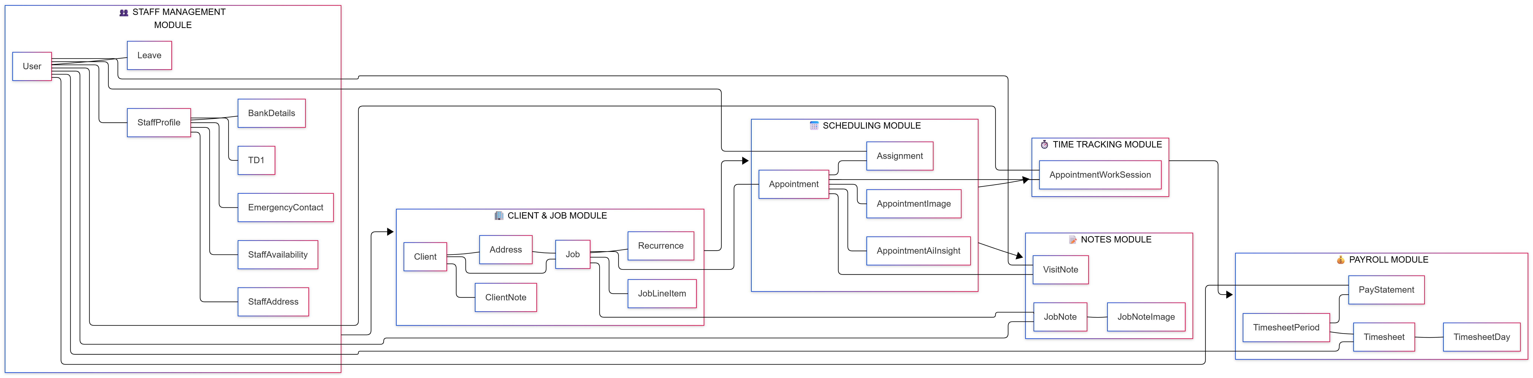
Database Structure

Slide 13
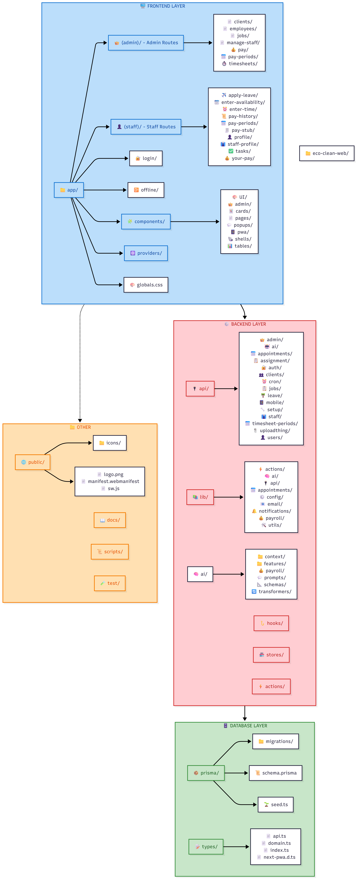
Code Structure

